Slide 1
Unit 201: Health and safety in building services engineering
Safety signs and symbols

Slide 2
Safety signs
If a hazard cannot be adequately controlled by any other means then it must be marked with a safety sign.
Every employer must ensure that their employees are trained in the meaning of safety signs.
Emergency escape routes and firefighting equipment must have their locations identified with safety signs.

Slide 3
Safety signs
Warning signs.
Information signs (advisory).
Mandatory signs.
Prohibition signs.

Slide 4

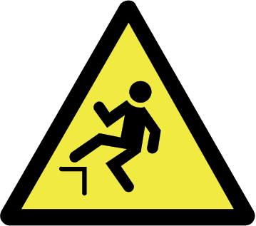

Warning signs
Danger Electricity
Drop
General

Slide 5
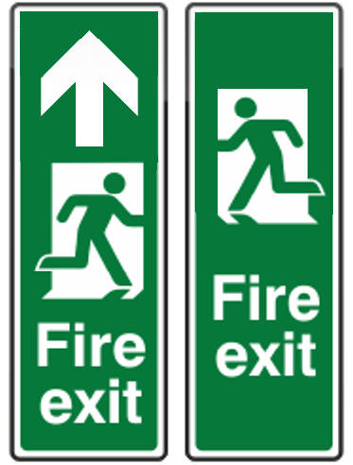


Information signs (advisory)
Fire Exit
First Aid
Fire Assembly Point

Slide 6



Mandatory signs
Safety helmet must be worn
Ear Protection must be worn
Eye Protection must be worn

Slide 7



Prohibition signs
No Smoking
Do Not Extinguish With Water
No unauthorised Persons

Slide 8
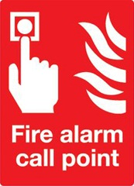
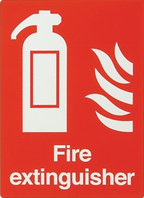
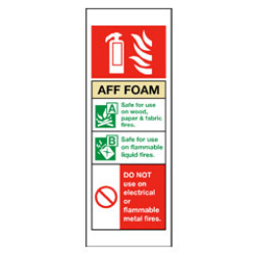
Firefighting equipment signs

Slide 9







Symbols for hazardous substances
Toxic:
Chemicals that at low levels cause damage to health.
Oxidising:
Chemicals that react exothermically with other chemicals.
Harmful:
Chemicals that may cause damage to health.
Highly flammable:
Chemicals that may catch fire in contact with air, only need brief contact with an ignition source, have a very low flash point or evolve highly flammable gases in contact with water.
Corrosive:
Chemicals that may destroy living tissue on contact.
Extremely flammable:
Chemicals that have an extremely low flash point and boiling point, and gases that catch fire in contact with air.

Slide 10
Unit 201: Health and safety in building services engineering
The End

